Slide 1
Algorithms analysis and Design
By : Dr. Basem Alijla

Slide 2
Chapter 5
Divide and Conquer technique

Slide 3
OUTLINE
Introduction to Divide and Conquer technique
Divide-and-Conquer Examples
Merge Sort Algorithm
Quick Sort Algorithm
Binary tree traversals
Closest-Pair Problem by Divide and Conquer
Binary search:

Slide 4
Divide-and-Conquer Technique
In politics , Divide is a combination of political, military, and economic strategy of gaining and maintaining power by breaking larger construction of power into chunks that individually have less power than the one who is implementing the strategy

Slide 5
Divide-and-Conquer Technique
The most-well known algorithm design strategy:
Three steps are involved in Divide and Conquer
Divide instance of problem into two or more smaller instances
Solve smaller instances recursively
Obtain solution to original (larger) instance by combining these solutions

Slide 6
Divide-and-Conquer Technique
a problem of size n
subproblem 1
of size n/2
subproblem 2
of size n/2
Don’t assume always
break up into 2 could be >2
Subproblems
a solution to
subproblem 1
a solution to
subproblem 2
a solution to
the original problem

Slide 7
Divide-and-Conquer Technique
Usually in div & Conq. A problem instance of size n is divided into two instances of size n / 2.
More Generally, it could be divided into b instances.
T(n) = a T (n / b) + f(n)

Slide 8
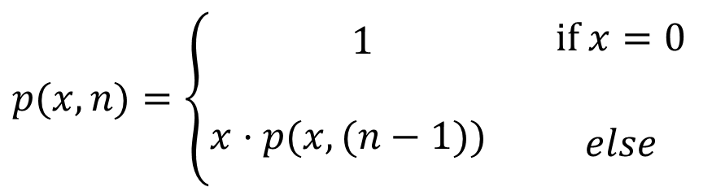
Example : Computing Powers
The power function, p(x,n)=x^{n} = x * x^{n-1}
^{O( n )}
$$p(x,n)=\left\{\begin{matrix}\begin{matrix}1 \\ \begin{aligned} \\ x⋅p(x,(n−1))^{}\end{aligned} \\ \end{matrix} & \begin{aligned}\text{if} x=0 \\ \begin{matrix} \\ \begin{aligned} \\ else\end{aligned} \\ \end{matrix}\end{aligned}\end{matrix}\right.$$

Slide 9
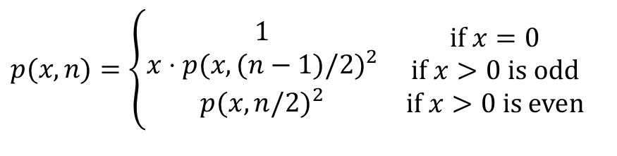
Example : Computing Powers
The power function, p(x,n)=x^{n} = x^{n/2} * x^{n/2}
Examples
2⁴ = 2^{(4/2)2} = (2^{4/2})² = (2²)² = 4² = 16
2⁵ = 2^{1+(4/2)2} = 2(2^{4/2})² = 2(2²)² = 2(4²) = 32
2⁶ = 2^{(6/ 2)2} = (2^{6/2})² = (2³)² = 8² = 64
2⁷ = 2^{1+(6/2)2} = 2(2^{6/2})² = 2(2³)² = 2(8²) = 128
$$p(x,n)=\left\{\begin{matrix}\begin{matrix}1 \\ x⋅p(x,(n−1)/2)^{2} \\ p(x,n/2)^{2}\end{matrix} & \begin{matrix}\text{if} x=0 \\ \text{if} x>0 \text{is} \text{odd} \\ \text{if} x>0 \text{is} \text{even}\end{matrix}\end{matrix}\right.$$

Slide 10
Analysis
Algorithm Power(x, n):
Input: A number x and integer n = 0
Output: The value x^{n}
if n = 0 then
return 1
if n is odd then
y = Power(x, (n - 1)/ 2)
return x · y · y
else
y = Power(x, n/ 2)
return y · y
Each time we make a recursive call we halve the value of n; hence, we make log n recursive calls. That is, this method runs in O(log n) time.
It is important that we use a variable twice here rather than calling the method twice.

Slide 11
Add n number using divide and conquer
Divide
2 | 4 | 3 | 5 | 7 | 1 | 6 | 9
2 | 4 | 3 | 5
7 | 1 | 6 | 9
2 | 4
3 | 5
7 | 1
6 | 9
Add
6
8
O( n)
8
15
14
23
37
# of additions is the same as in brute force , need stack for recursion , it could be better for parallel processor thought
Not all Divide and Conquer works

Slide 12
OUTLINE
Introduction to Divide and Conquer strategy
Divide-and-Conquer Examples
Merge Sort Algorithm
Quick Sort Algorithm
Binary tree traversals
Closest-Pair Problem by Divide and Conquer
Binary search:

Slide 13
Mergesort
Split array A[0..n-1] in two about equal halves and make copies of each half in arrays B and C
Sort arrays B and C recursively
Merge sorted arrays B and C into array A as follows:

Slide 14
Mergesort
Repeat the following until no elements remain in one of the arrays:
compare the first elements in the remaining unprocessed portions of the arrays
copy the smaller of the two into A, while incrementing the index indicating the unprocessed portion of that array
Once all elements in one of the arrays are processed, copy the remaining unprocessed elements from the other array into A.

Slide 15
Mergesort Example
Divide
8 | 3 | 2 | 9 | 7 | 1 | 5 | 4
8 | 3 | 2 | 9
7 | 1 | 5 | 4
8 | 3
2 | 9
7 | 1
5 | 4
8
3
2
9
7
1
5
4
Merge
3 | 8
2 | 9
1 | 7
4 | 5
2 | 3 | 8 | 9
1 | 4 | 5 | 7

Slide 16
Mergesort Example
Divide
8 | 3 | 2 | 9 | 7 | 1 | 5 | 4
8 | 3 | 2 | 9
7 | 1 | 5 | 4
8 | 3
2 | 9
7 | 1
5 | 4
8
3
2
9
7
1
5
4
Merge
3 | 8
2 | 9
1 | 7
4 | 5
2 | 3 | 8 | 9
1 | 4 | 5 | 7
1

Slide 17
Mergesort Example
Divide
8 | 3 | 2 | 9 | 7 | 1 | 5 | 4
8 | 3 | 2 | 9
7 | 1 | 5 | 4
8 | 3
2 | 9
7 | 1
5 | 4
8
3
2
9
7
1
5
4
Merge
3 | 8
2 | 9
1 | 7
4 | 5
2 | 3 | 8 | 9
1 | 4 | 5 | 7
1 | 2

Slide 18
Mergesort Example
Divide
8 | 3 | 2 | 9 | 7 | 1 | 5 | 4
8 | 3 | 2 | 9
7 | 1 | 5 | 4
8 | 3
2 | 9
7 | 1
5 | 4
8
3
2
9
7
1
5
4
Merge
3 | 8
2 | 9
1 | 7
4 | 5
2 | 3 | 8 | 9
1 | 4 | 5 | 7
1 | 2 | 3

Slide 19
Mergesort Example
Divide
8 | 3 | 2 | 9 | 7 | 1 | 5 | 4
8 | 3 | 2 | 9
7 | 1 | 5 | 4
8 | 3
2 | 9
7 | 1
5 | 4
8
3
2
9
7
1
5
4
Merge
3 | 8
2 | 9
1 | 7
4 | 5
2 | 3 | 8 | 9
1 | 4 | 5 | 7
1 | 2 | 3 | 4

Slide 20
Mergesort Example
Divide
8 | 3 | 2 | 9 | 7 | 1 | 5 | 4
8 | 3 | 2 | 9
7 | 1 | 5 | 4
8 | 3
2 | 9
7 | 1
5 | 4
8
3
2
9
7
1
5
4
Merge
3 | 8
2 | 9
1 | 7
4 | 5
2 | 3 | 8 | 9
1 | 4 | 5 | 7
1 | 2 | 3 | 4 | 5

Slide 21
Mergesort Example
Divide
8 | 3 | 2 | 9 | 7 | 1 | 5 | 4
8 | 3 | 2 | 9
7 | 1 | 5 | 4
8 | 3
2 | 9
7 | 1
5 | 4
8
3
2
9
7
1
5
4
Merge
3 | 8
2 | 9
1 | 7
4 | 5
2 | 3 | 8 | 9
1 | 4 | 5 | 7
1 | 2 | 3 | 4 | 5 | 7

Slide 22
Mergesort Example
Divide
8 | 3 | 2 | 9 | 7 | 1 | 5 | 4
8 | 3 | 2 | 9
7 | 1 | 5 | 4
8 | 3
2 | 9
7 | 1
5 | 4
8
3
2
9
7
1
5
4
Merge
3 | 8
2 | 9
1 | 7
4 | 5
2 | 3 | 8 | 9
1 | 4 | 5 | 7
1 | 2 | 3 | 4 | 5 | 7 | 8 | 9

Slide 23
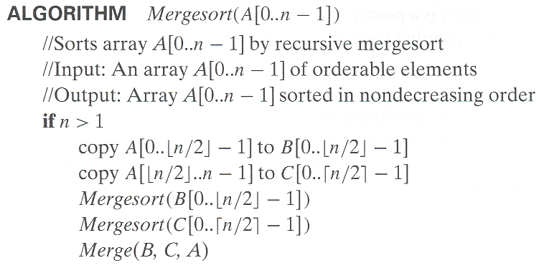
Pseudocode of Mergesort

Slide 24
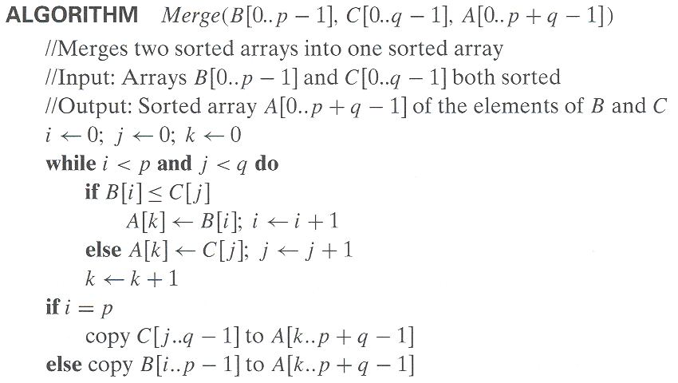
Pseudocode of Mergesort

Slide 25
Time efficiency of mergesort
T(n) = 2T(n/2) + TMerge(n) for n > 1,
T(1) = 0
In worst-case TMerge(n) = n-1
T(n) = 2T(n/2) + n-1
a = 2, b = 2 , d = 1
Master Theory :
If a = b^{d}, T(n) ∈ O(n^{d} log n) = O( n log n )

Slide 26
Time efficiency of mergesort
MergerSort
Time Efficiency in all cases is O ( nlog n)
Space requirement: O(n) (not in-place)

Slide 27
OUTLINE
Introduction to Divide and Conquer strategy
Divide-and-Conquer Examples
Merge Sort Algorithm
Quick Sort Algorithm
Binary tree traversals
Closest-Pair Problem by Divide and Conquer
Binary search:

Slide 28
Quicksort
Another divide and conquer based sorting algorithm
Quicksort uses the idea of partitioning
Select a pivot (partitioning element) (P) – here, the first element
Rearrange the list so that all the elements
The first s positions are ≤ P
The remaining n-s positions are > P
p
A[i]≤p
A[i]>p

Slide 29
Quicksort
Exchange the pivot with the last element in the first (i.e., ≤) subarray — the pivot is now in its final position
Sort the two subarrays recursively

Slide 30
QuickSort Example
P = 5
5 | 3 | 1 | 9 | 8 | 2 | 4 | 7
i
j

Slide 31
QuickSort Example
P = 5
5 | 3 | 1 | 9 | 8 | 2 | 4 | 7
i
j
P = 5
5 | 3 | 1 | 4 | 8 | 2 | 9 | 7
i
j

Slide 32
QuickSort Example
P = 5
5 | 3 | 1 | 4 | 8 | 2 | 9 | 7
i
j

Slide 33
QuickSort Example
P = 5
5 | 3 | 1 | 4 | 8 | 2 | 9 | 7
i
j
P = 5
5 | 3 | 1 | 4 | 2 | 8 | 9 | 7
j
i
P = 5
5 | 3 | 1 | 4 | 2 | 8 | 9 | 7
j
i

Slide 34
QuickSort Example
P = 5
5 | 3 | 1 | 4 | 2 | 8 | 9 | 7
j
i
P = 5
2 | 3 | 1 | 4 | 5 | 8 | 9 | 7

Slide 35
QuickSort Example
P = 5
5 | 3 | 1 | 9 | 8 | 2 | 4 | 7
P = 2
P = 8
2 | 3 | 1 | 4 | 5
8 | 9 | 7
1 | 2
9
3 | 4 | 5
7 | 8
1
2
3
4 | 5
7
8
4
5

Slide 36
Quick Sort Algorithm

Slide 37
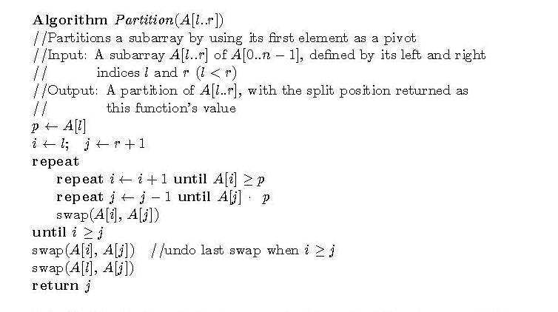
Partitioning Algorithm

Slide 38
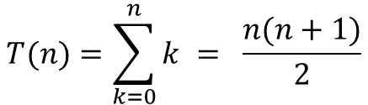
Analysis of Quicksort
Cbest(n) = 2Cbest(n/2) + n for n > 1, Cbest(1) = 0
Master Theory , O(n logn )
Worst Case :
1 | 2 | 3 | 4 | 5 | 7 | 8 | 9
1
2 | 3 | 4 | 5 | 7 | 8 | 9
2
3 | 4 | 5 | 7 | 8 | 9
$$T(n)=\sum_{k=0}^{n}{k = \frac{n(n+1)}{2}}$$
3
4 | 5 | 7 | 8 | 9
4
5 | 7 | 8 | 9
5
7 | 8 | 9
O(n²)
7
8 | 9
8
9

Slide 39
Analysis of Quicksort
Best case: split in the middle — Θ(n log n)
Worst case: sorted array! — Θ(n²)
Average case: random arrays — Θ(n log n)
Improvements:
better pivot selection: median of three partitioning
switch to insertion sort on small subfiles
elimination of recursion

